Slide 1

Project Phase-2
Department of Artificial Intelligence
Group - 10
Semester-8
Project Mentor:
Prof Achamma Thomas
Group member:
Abhiroop Sarkar
Prateek Dutta
Adnan Quraishee
Saurabh Barse
Malware detection System using Deep Learning

Slide 2
Malware ..
Malware is one of the most serious security threats on the Internet today.
The malware industry continues to be a well-organized, well-funded market dedicated to evading traditional security measures.
Once a computer is infected by malware, criminals can hurt consumers and enterprises in many ways.

Slide 3
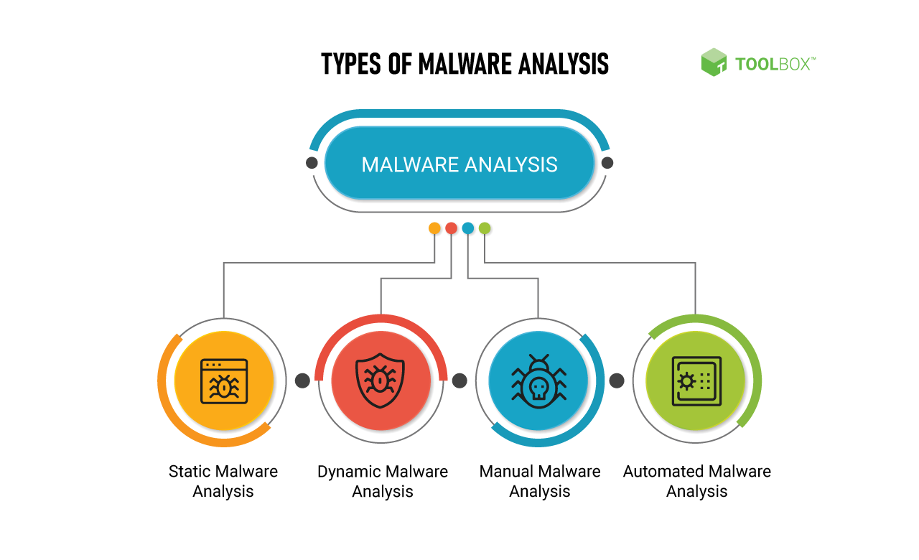

Slide 4


Slide 5

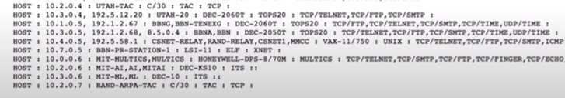
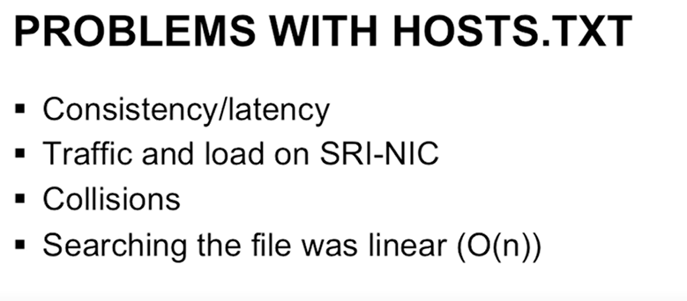
HISTORY
In the beginning there was HOST.TXT, which was a single monolithic file mapping the names of all the ARPANET's hosts to there address.
Maintained by single organisation SRI's Network Information Centre and distributed from same single point.

Slide 6

DNS Attack

Slide 7
Types of DNS attacks
Domain hijacking
DNS flood attack
Distributed Reflection Denial of Service (DRDoS)
Cache poisoning
DNS tunnelling
DNS hijack attack
Random subdomain attack
NXDOMAIN attack
Phantom domain attack

Slide 8
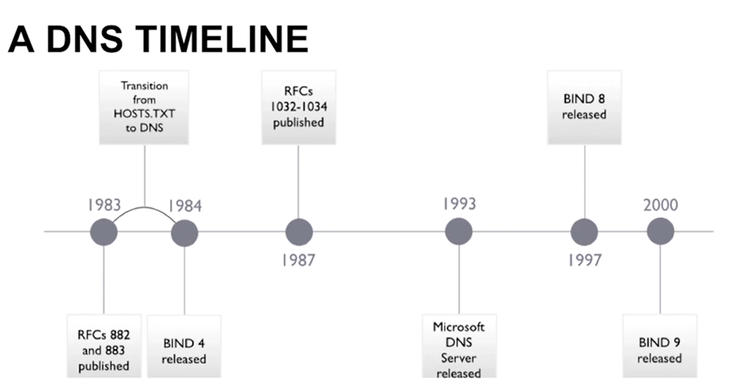
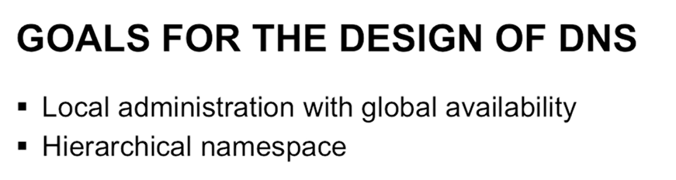

Slide 9
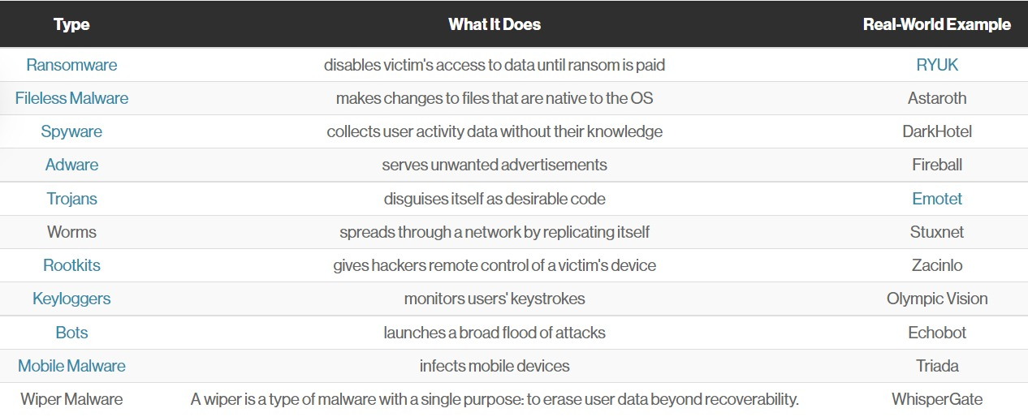
Types of Malware

Slide 10

Solving approach

Slide 11
Why Deep Learning
One of the key advantages of machine-based approaches is that they can adapt to new and previously unseen malware threats, whereas traditional signature-based approaches can only detect known malware variants.
Models can be trained on large datasets of both benign and malicious software to learn the characteristics that distinguish malware from legitimate software, allowing them to identify new, unknown malware based on these learned patterns.
Deep learning models are particularly well-suited for identifying patterns and features in complex, high-dimensional data, such as the raw binary code of software applications, which can be a challenging task for traditional machine learning algorithms.
These networks learn to extract relevant features from the binary code, such as opcode sequences and control flow graphs, that can be used to distinguish between malicious and legitimate software.
Once trained, these models can be used to classify new, previously unseen software as either malware or benign.

Slide 12
Why Deep Learning
Nowadays deep learning has dominated the various computer vision tasks.
Not only these deep learning techniques enabled rapid progress in this competition, but even surpassed human performance in many of them.
One of these tasks is Image Classification. Unlike more traditional methods of machine learning techniques, deep learning classifiers are trained through feature learning rather than task-specific algorithms.

Slide 13
Dataset
We are using EMBER (Elastic Malware Benchmark for Empowering Researchers) dataset for our project and research purpose.
The EMBER dataset is a collection of features from PE (Portable Executable) files that serve as a benchmark dataset for researchers.
The EMBER2017 dataset contained features from 1.1 million PE files scanned in or before 2017 and the EMBER2018 dataset contains features from 1 million PE files scanned in or before 2018.
The dataset includes features extracted from 1.1M binary files: 900K training samples (300K malicious, 300K benign, 300K unlabeled) and 200K test samples (100K malicious, 100K benign).

Slide 14
About Dataset
The EMBER dataset consists of a collection of JSON lines files, where each line contains a single JSON object. Each object includes the following types in data:
• The sha256 hash of the original file as a unique identifier;
• Coarse time information (month resolution) that establishes an estimate of when the file was first seen;
• A label, which may be 0 for benign, 1 for malicious or -1 for unlabeled; and
• Eight groups of raw features that include both parsed values as well as format-agnostic histograms.

Slide 15
THANK YOU

